Slide 1
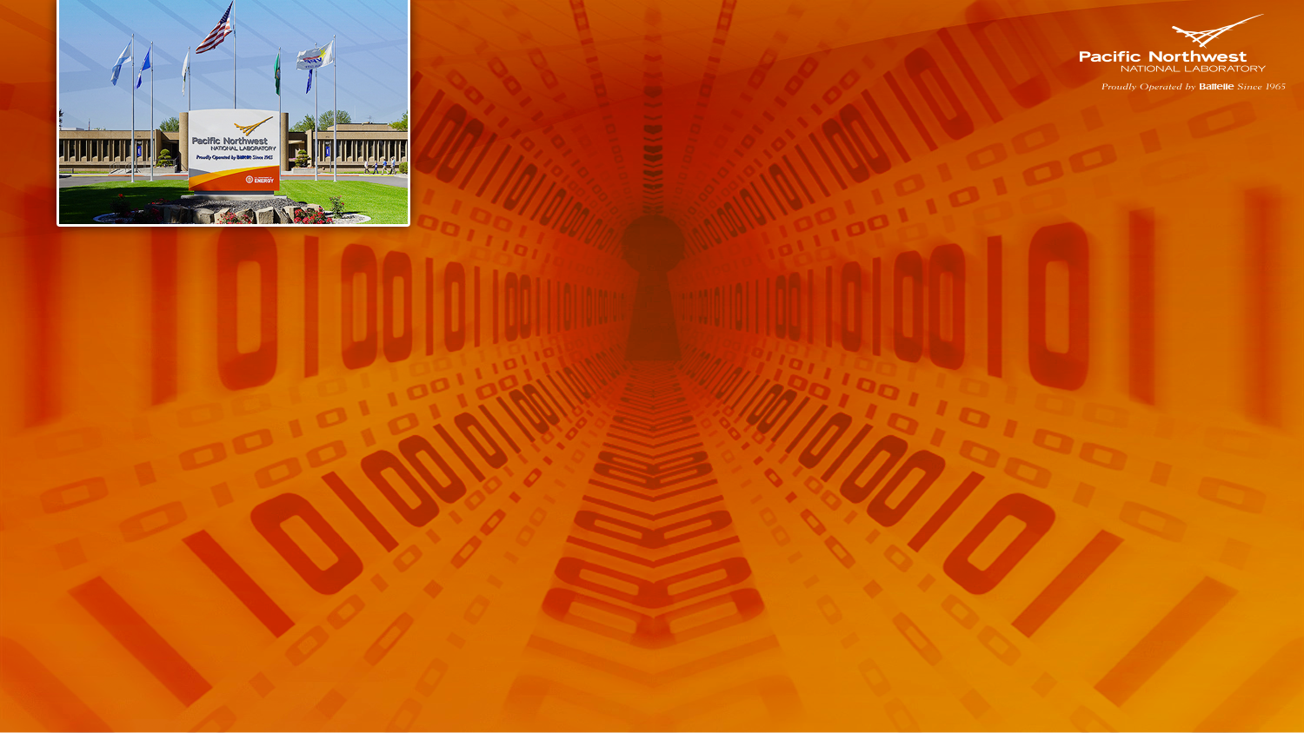
Windows Logging Service
Craig Strait
Craig.strait@pnnl.gov
Cyber Security Architect

Slide 2

About Me
My name is Craig Strait
I’ve worked at PNNL for 10 years
Cyber Security Architect
I also do Incident Response and Penetration Testing
I am passionate about network defense

Slide 3
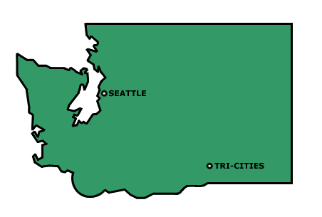
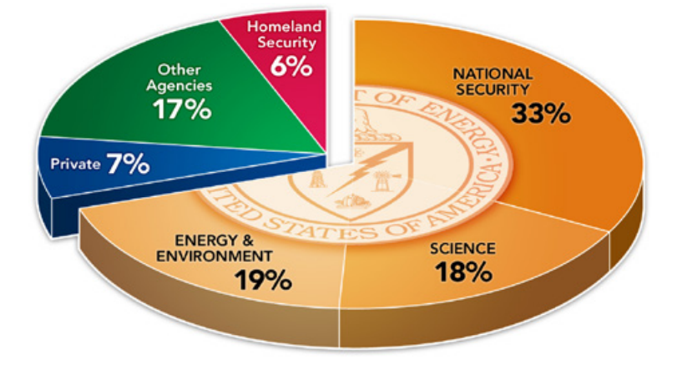
About Pacific Northwest National Laboratory
4400 Scientist, Engineers, and Staff
Interdisciplinary DOE Office of Science Laboratory
  Chemical and Molecular Sciences
  Chemical Engineering
  Biological Systems Science
  Climate Change Science
  Environmental Subsurface Science
  Applied Materials Science
  Applied Nuclear Science
  Advanced Computer Science, Visualization, and Data
  Systems Engineering and Integration

Slide 4
Introduction
This is about Cyber Security
This is about logs
This is about a tool
This is about gaining an advantage over the attacker

Slide 5
Intro
This is a Cyber Security talk
Focused on a Windows logging tool
How this tool is better and nothing else comes close
The advantage gained over the attacker because of this tool

Slide 6
Find badness

Slide 7

Intrusion Detection

Slide 8
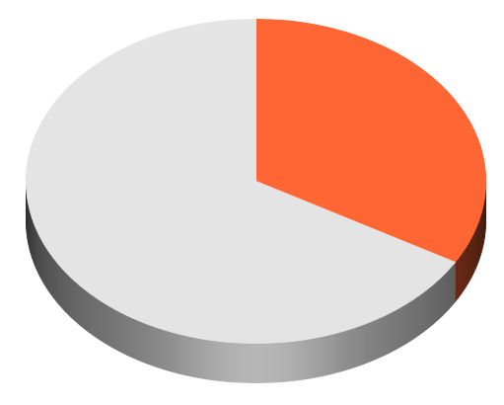

Intrusion Detection
33% of advanced intrusions detected by internal teams
Internal Teams
External Notification
* http://www.mandiant.com/resources/m-trends

Slide 9
Intrusion Detection
The attackers have adapted.
Notes:
Impersonate Users
Live off the land

Slide 10
Intrusion Detection
2004 called, they want their IDS back.
Notes:
* Detecting intention

Slide 11



Intrusion Detection
The party has moved.

Slide 12
Where did the party go?
Data is stolen via the host
Key-loggers run on the host
Command and Control of the host
Malware is executed upon the host
Lateral Movement initiates from the host
Intellectual Property is generated on the host

Slide 13
Where did the party go?
Collecting Windows logs is a must in 2014

Slide 14

Where did the party go?
Logs are useless without a way to search.

Slide 15
Log Forwarders
Splunk
Universal Forwarder
Snare Forwarder
They all suffer the
same basic problem
Google Code:
eventlog-to-syslog
Microsoft
Event Subscription

Slide 16
Log Forwarders
They all suffer the
same basic problem
Native Windows logs
have low cyber value

Slide 17
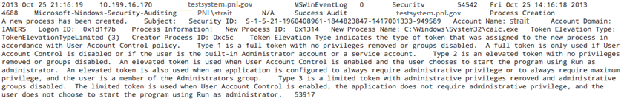
Windows Logs
Written by developers for developers
IP Address
System hostname
Username
Process that was Executed
10.1.4.66
testsystem.pnl.gov
PNL\strait
C:\windows\system32\calc.exe

Slide 18
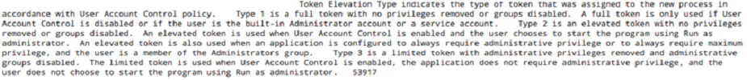
Windows Logs
Written by developers for developers
This is all noise!

Slide 19





Windows Logging Service
Three Steps To Do It Better
Step 1: Jettison the narrative
Step 2: Enrich the logs with data of Cyber value
Step 3: Collect highly targeted system data not available via Windows Event Logger

Slide 20

Windows Logging Service
About
Developed at Kansas City Plant by Jason McCord
  Contributors: Jon Green, Brian Findley, Geoff Jones, Patrick Avery, Alex Quintana, Craig Strait, Mark Bradford, Eric Hill, Jesse Trucks, Keith Tyler, Chris DesRocher
Available free of charge for US Govt
Commercial licenses available

Slide 21

Windows Logging Service
About
Windows Event Log to Syslog forwarder
Software agent
Microsoft Windows OS only
High customizable
Surgical filtering of logs

Slide 22
Windows Logging Service
Step 1
Remember the narrative?
Get rid of it.

Slide 23
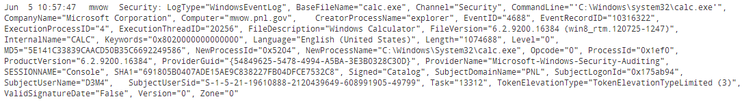
Windows Logging Service
Step 2: Enrich the logs with data of Cyber value
Full path including command line arguments.
Description
Parent Process
Who wrote it?
Windows Process ID
What is the file version?
Process Name
Language
calc.exe
C:\Windows System32\calc.exe
Microsoft Corporation
explorer
Windows Calculator
6.2.9200 (win8_rtm…
English
1074KB
7920
5E141C33839CAACD50B35C6692249586
5204
Console
True
Token Type 3
False
False
Remote Desktop
or
Keyboard?
MD5 Hash
(file finger print)
Digital Signature?
Was it run as
Admin?
Parent Process ID
File Size
Valid Signature Date?
Zone: Did it come from the Internet?

Slide 24
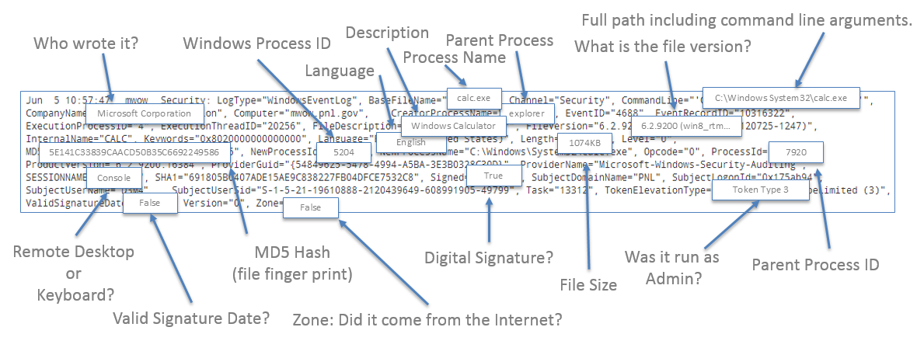
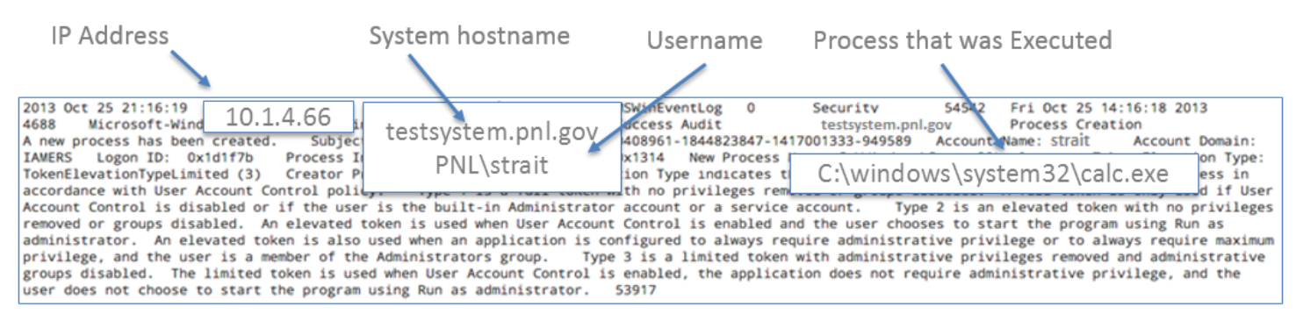
Windows Logging Service
1792 Bytes
2210 Bytes
With
Without

Slide 25
Windows Logging Service
STEP 3: Collect Highly Targeted System Data
not available via native Windows Logs
Module Monitor (.DLLs)
Named Pipe Monitor
WinObject Monitor
Command Shell Monitor
Session Monitor
Device Monitor
Certificate Monitor
Drive Monitor
File Monitor
Port Monitor
Registry Monitor

Slide 26
Windows Logging Service
Module Monitor (.DLLs)
File Description
.DLL file name
Company Name
Microsoft Corporation
MFCDLL Shared Library – Retail Version
mfc90u.dll
9.00.30729.6161
English (United States)
CA6ADE4F7761BB15B3325356DC3B82BB
NewHash=True
Outlook.exe
File Version
Language
MD5 Hash
New Hash?
Parent Executable

Slide 27
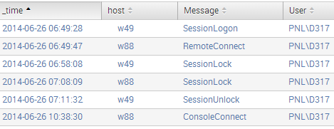
Windows Logging Service
Session Monitor

Slide 28
Windows Logging Service
Named Pipe Monitor
Name=“winreg”
WinObject Monitor
Mutexes and Semaphores
Name=\BaseNamedObjects\_?_c:_programdata_Microsoft_rac_temp_sq13ab9.tmp:x

Slide 29
Windows Logging Service
Device Monitor

Slide 30
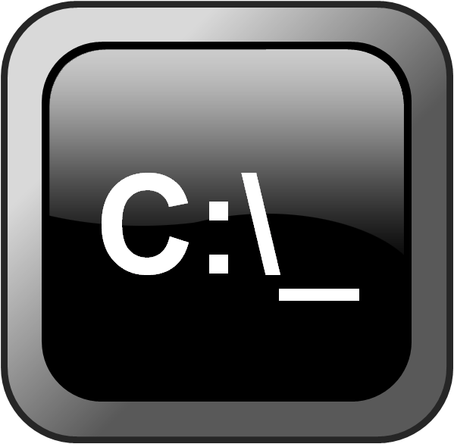
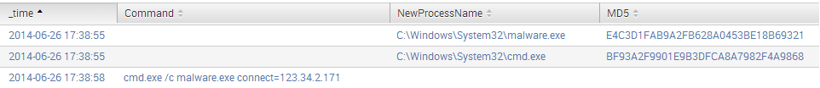
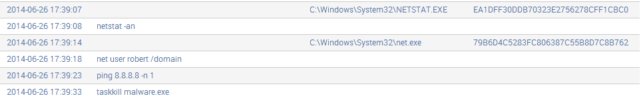
Windows Logging Service
Command Prompt Monitoring

Slide 31
Windows Logging Service
Other Custom Logging
Certificate Monitor: | Discover which certificates are loaded
Drive Monitor: | Interaction with USB drives
File Monitor: | Watch specific files for changes (tripwire)
Port Monitor: | New TCP & UDP Listeners
Registry Monitor: | Monitor keys for changes (Locations where Malware loads itself)

Slide 32
Windows Logging Service
Other Features:
Performance Counters: | Log data from Windows Performance Monitor
Network Awareness: | Change SYSLOG servers based on local network address
SSL Forwarding: | Forward logs via SSL
Filtering: | Highly configurable filters

Slide 33
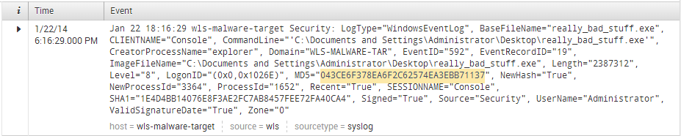
Windows Logging Service
Malware Infection Tracking
Malware executed from the console
(not Remote Desktop)
Process that was Executed
MD5
“really_bad_stuff.exe”
Console
Let’s search for Process ID 3364 on this system
043CE6F378EA6F2C62574EA3EBB71137
NewHash=True
3364
Signed=“True”
Administrator
Username that executed malware
Process ID of Malware
Digitally Signed Malware
The system has never
seen this executable before.

Slide 34
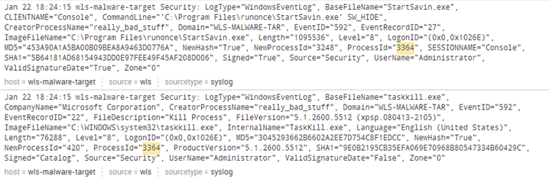
Windows Logging Service
Malware Infection Tracking
Malware Launches StartSavin.exe
StartSavin has a ProcessID of 3248
C:\program files\runonce\StartSavin.exe SW_HIDE
NewHash=“True”
3248
Let’s search for Process ID 3248 (StartSavin) on this system
Taskkill.exe
Malware Launches Taskkill.exe
Workstation has never executed this file before

Slide 35
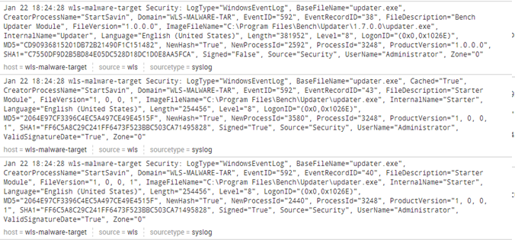
Windows Logging Service
Malware Infection Tracking
Unique Hash
C:\program files\Bench\Updater\1.7.0.0\updater.exe
1.7.0.0
CD90936815201DB72B21490F1C151482
Signed=False
Three instances of “updater.exe” launched
C:\program files\Bench\Updater\updater.exe
2064E97CF3396C4EC5A497CE49E4515F
Signed=True
C:\program files\Bench\Updater\updater.exe
2064E97CF3396C4EC5A497CE49E4515F
Signed=True

Slide 36
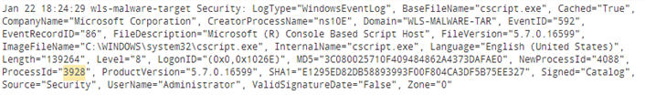
Windows Logging Service
Malware Infection Tracking
Parent
StartSavin.exe ProcessID: 3248
3248
Child
Parent
3928
3248
Child
4088
3928
Port=1204
4088
UDP
Listening on UDP Port 1204

Slide 37
Windows Logging Service
Malware Infection Tracking
The malware has been partially Reverse Engineered in real time
Search the enterprise for other instances of the malware via:
MD5 Hashes
UDP Port 1204
Mutants or Semaphores
Dynamically Linked Libraries

Slide 38
Windows Logging Service
Malware Infection Tracking
The malware has been partially Reverse Engineered in real time
Search the enterprise for other instances of the malware via:
MD5 Hashes
UDP Port 1204
Mutants or Semaphores
Dynamically Linked Libraries

Slide 39
Windows Logging Service
In Closing…
Visibility into what the host is doing is lacking
WLS solves this problem
Get rid of the noise
Enrich the logs
Collect addition highly targeted
4) ???
???
Profit!

